Slide 1
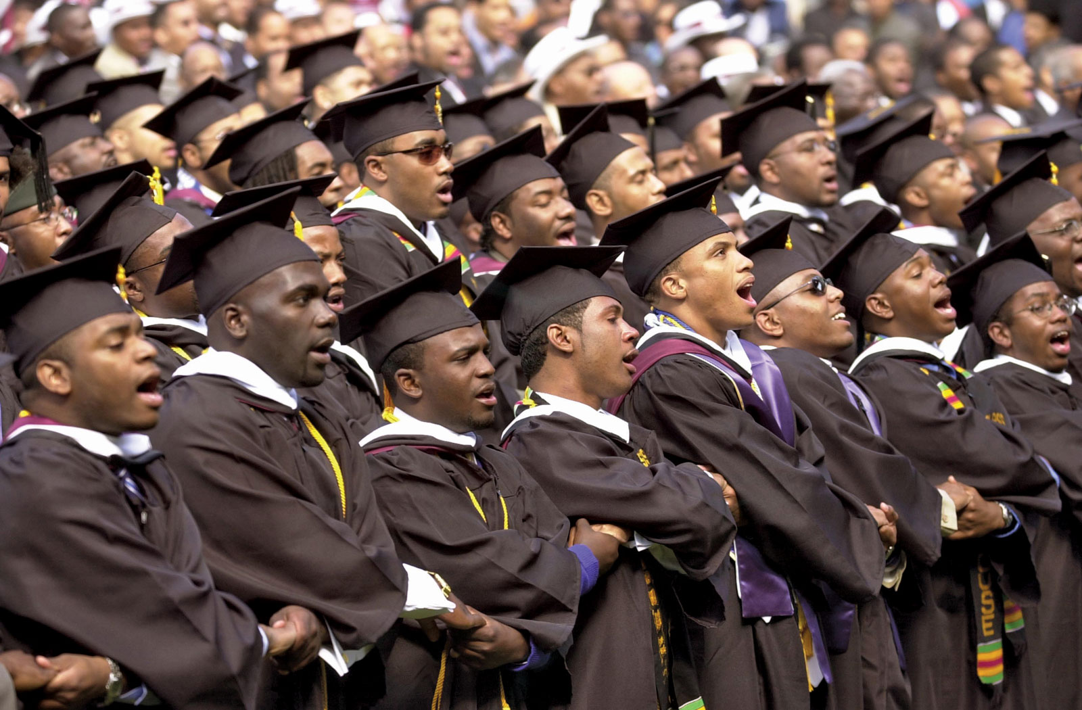
Building Future Leaders
5 Steps to Supporting Male Students
By Brandon Q. Jackson, M.Ed.

Slide 2
The Problem:
The number of boys growing up without fathers in their lives has reached epidemic proportions. High rates of divorce and out-of-wedlock births have created a generation of fatherless boys.
The Magnitude of the Epidemic
One in three children are born to unmarried parents.
An estimated 24.7 million children do not live with their biological father.
43% of urban teens live away from their father.
42% of fathers fail to see their children at all after divorce.
Since 1960 the rate of U.S. boys without fathers has quadrupled.
1 in 6 black men had been incarcerated as of 2001. If current trends continue, 1 in 3 black males born today will spend time in prison in his lifetime.

Slide 3
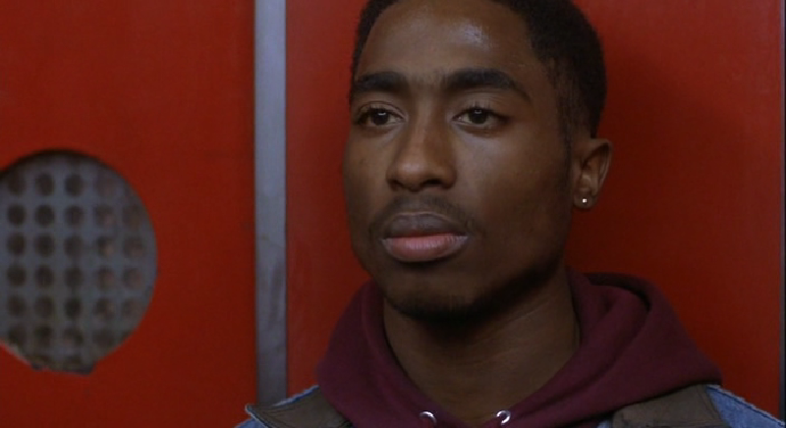
The Reality

Slide 4
Issues Facing Our Male Students
Low Achievement Levels
High Suspension & Expulsion Rates
Single-Parent Homes
Lack of Positive Male Role Models
Violence

Slide 5
Male/Identity vs. Role & Confusion Stage/ Ages 12-18
When social demands and roles become complicated, males have a hard time maintaining a sense of self.
Males struggle to find their true selves. There is a battle when males struggle with who they are and who they would like to become.
Males may try a number of identities on the way to their true self.
There is a struggle for our male students to achieve masculinity. The problem that occurs is that our young men must be trained to reach masculinity. How can there be training when there is no one to train them?

Slide 6
1) Plan That Works
Identify who will be instrumental in implementing a plan that WILL make a difference in the lives of our male students present at Lawrence North
Identifying Data (Number of 9th & 10th grade males in our school, how many come from single-parent homes, how many are on free & reduced)
Measuring success of program
( What Tuesday will look like)Cadence calls, discussion of topic, activity, and reflection
Everything is geared toward academic success & development of character

Slide 7
2) Resilience & Optimism
Statistics, news reports, and test data indicate that our males are struggling. When we implement interventions that promote resilience & optimism the desired outcomes are: Our Objectives
Males will begin to see their potential for greatness regardless of past mistakes or current life situations
Males will have the ability to bounce back during adversity and have the self-discipline to say no to things that can hinder academic success
Males will have the ability to have positive outcomes in various social settings. Example: Debate team, college, middle school, etc.

Slide 8
3) Knowing What To Address
Friendships
Peer groups
Dating and romantic relationships
Sexuality
Self-esteem
Parent and family relationships
Ethnicity
What do our male students struggle with?

Slide 9
4) Managing Failure
It’s not our job to prevent failure, but how do we teach our males to learn from failure?
Confronting Issues vs. Running Away
Fear of not being a success vs. having other desires to do anything else (NBA, NFL, Rapper, and Being Famous)
5 P’s= Prior Preparation Promotes Perfect Performance
Always use Examples ( Malcom X, Common, and mentors)

Slide 10
5) Responsibility & Accountability
Why would this be an important step as we look to strengthen our male students?

Slide 11
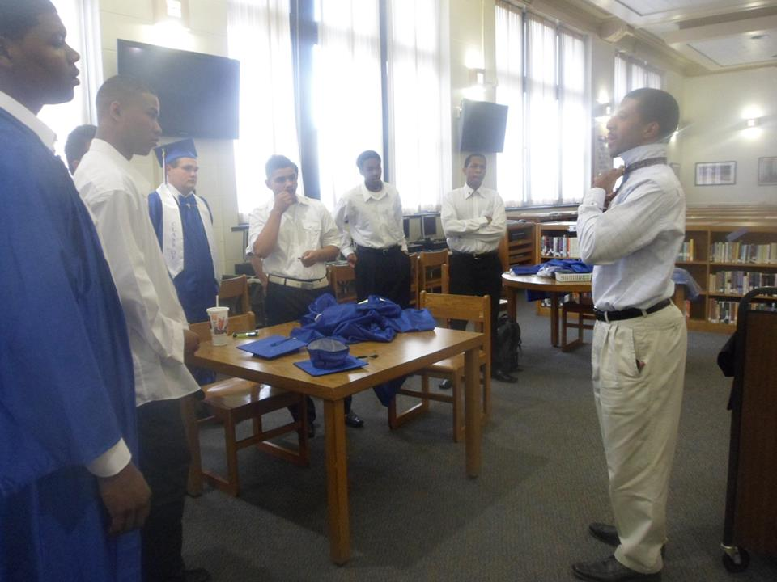
End Result

Slide 12
Timeline
Launch of Program on Jan. 12th at 4pm
Sessions will occur every Tuesday
Two Mentor per session
On Course/ Why Try
Community Service/Weekend of Presidents Day
Assessments Done once a month to track progress
Team building activity over summer
Start second week of school in fall
Discussed during freshman & sophomore orientation

