Slide 1
Character Counts: What Are Colleges Looking For?
Fom BigFuture through Collegeboard

Slide 2
What are college admission officers looking for when they read your application?
They take into account more than your GPA and test scores. Your character and the personal qualities you can bring to a college are important too. That’s why you need to think about your goals, accomplishments and personal values and figure out how you can best express those in your applications.

Slide 3
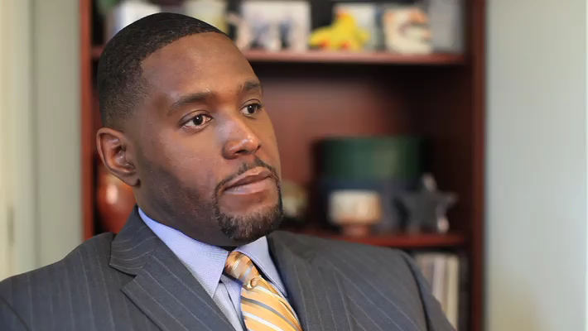
Earl Johnson, Associate Vice President and Dean of Admission, University of Tulsa

Slide 4
Qualities
Leadership
A willingness to take risks
Initiative
A sense of social responsibility
A commitment to service
Special talents or abilities

Slide 5
They want the class valedictorians, says Marty O’Connell, executive director of Colleges That Change Lives. But they also are looking for “students who are going to be involved in a lot of activities and students who are musicians and students who are athletes and everything in between.”

Slide 6
So how do I show colleges what is Special about Me?

Slide 7
Extracurricular Activities
What you do outside the classroom reveals a lot about you. That’s why some applications ask for details about extracurricular activities. But remember, it’s not the number of activities that’s important. Admission officers want to know what you’ve learned and how you’ve grown from participating in these activities.
  School Activities
  Community Activities
  Work
  Volunteering

Slide 8
Summer Jobs and Activities
Your summer experiences provide insight into your character. And holding a summer job at a fast-food restaurant can build as much character as attending a prestigious summer learning program. It's all about what you’ve gained, what you’ve learned and how you communicate that.

Slide 9
College Essay
The college essay gives you the opportunity to show the admission officers who you are and how you will contribute to the college campus.
Mike Sexton, vice president for enrollment management at Santa Clara University, says that when admission officers read student essays, they ask themselves, “Would you like this person to be your roommate? Would you like to work on a group project with this person?” The essay can reveal the answers to these questions more than any test score can.

Slide 10
College Essay (Con’t)
Do share your personal story and thoughts, take a creative approach and highlight areas that aren’t covered in other parts of the application, like your high school records.
Do focus on one aspect of yourself so the readers can learn more about who you are. Remember that the readers must be able to find your main idea and follow it from beginning to end. Ask a parent or teacher to read just your introduction and tell you what he or she thinks your essay is about.
Do include specific details, examples, reasons and so on to develop your ideas. Describe a situation when you were surrounded by various types of people. What were you doing? Whom did you talk with? What did you take away from the experience?
Do write in your own voice. For the above example, you could write about a real experience that you had and how it made you feel you had to take action. And note that admission officers will be able to tell if your essay was written by an adult.

Slide 11
Recommendation Letters
Recommendation letters can tell a lot about the kind of person you are. A teacher who knows you well can give insight into not just your academic strengths but also the qualities you display in class, such as leadership or fairness.

Slide 12
Other useful tips to keep in mind
High School GPA and Class Rank
AP/Dual Credit and Honors Classes
Test Scores

