Slide 1
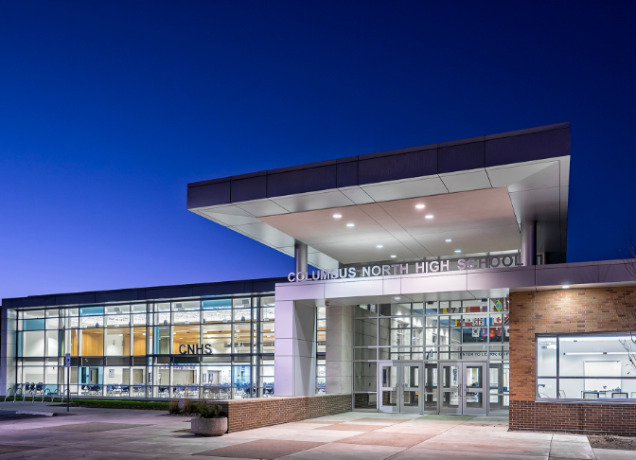
Welcome
CNHS
Class of 2021

Slide 2


Today’s Goal:
Use all available resources to choose classes for the 2017-2018 school year to best prepare you for a successful future.

Slide 3

Dear 9th Grade Me…

Slide 4


Future Bulldogs
8th Grade Family Night Handout

Slide 5
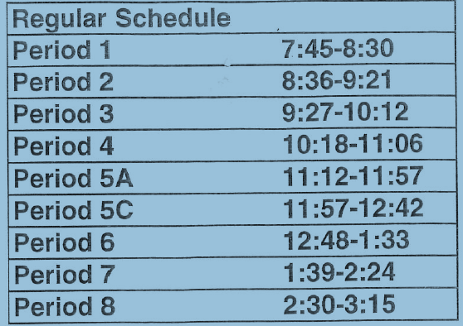
8 Classes Each Day
45 Minute Classes
6 Minute Passing Periods

Slide 6
Lunch
2 lunch periods (A & C)
45 minutes
9th graders eat in the cafeteria
Lunch assignments are random and may change at semester.

Slide 7

More Info
Bull Dog Time
Freshman Orientation

Slide 8
What is a credit?

Slide 9
What is a credit?
A credit is earned when students “Pass” a semester of a high school class.
A credit is earned for any grade of D- or higher at the end of each semester. Only semester grades earn credit!
All students must earn at least 40 credits to graduate.

Slide 10
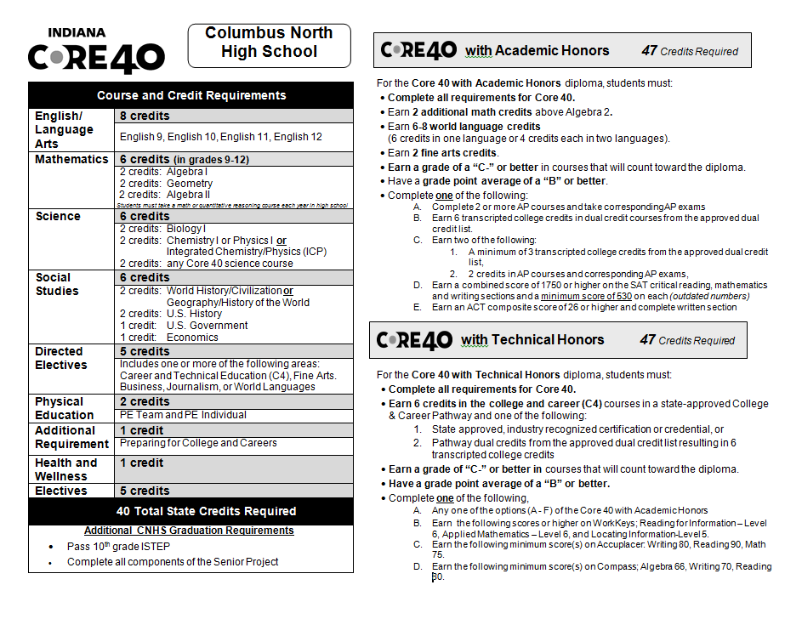
In your 9th grade “Preparing for College and Careers” class you will learn about the diploma requirements and create your 4 year course plan!

Slide 11

Choosing Classes
Detailed information can be found in the FULL Course Catalog!

Slide 12
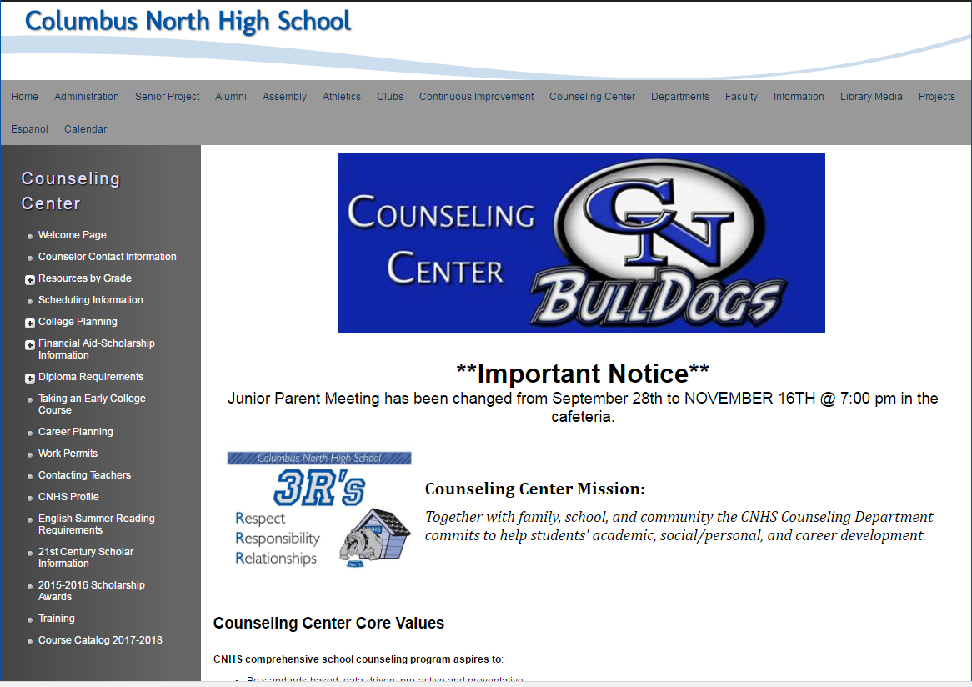
Columbus North website
Click “Counseling Center”
Click “Course Catalog 2017-2018”

Slide 13
Choosing Classes
If you are in a high school course right now and earn a C+ or lower for your semester grade, we recommend you retake that course in high school.

Slide 14

Choosing Classes

Slide 15
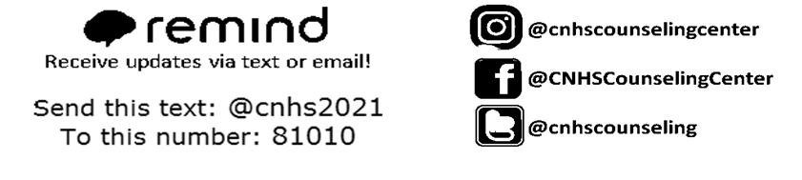
Choosing Classes

Slide 16
Choosing Classes
Open your Freshman Course Catalog.
As we review your choices, circle
the courses that interest you.

Slide 17

Choosing Classes

Slide 18
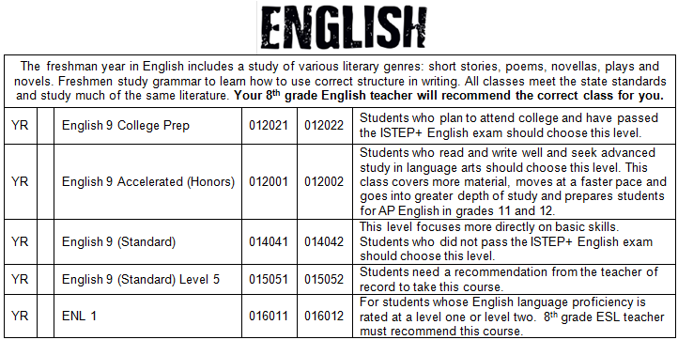
Read the descriptions.
Circle the class you THINK you may take.
Course Numbers
(
)

Slide 19
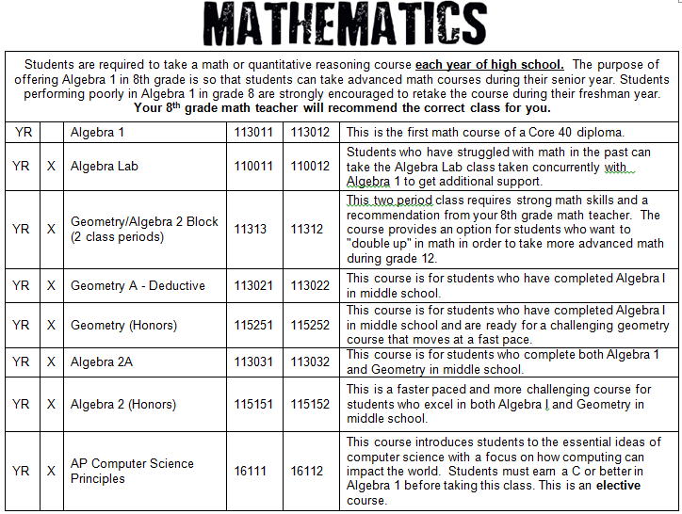
Circle the Math class that you believe is best for you.
Ask your Math teacher for his/her recommendation.

Slide 20
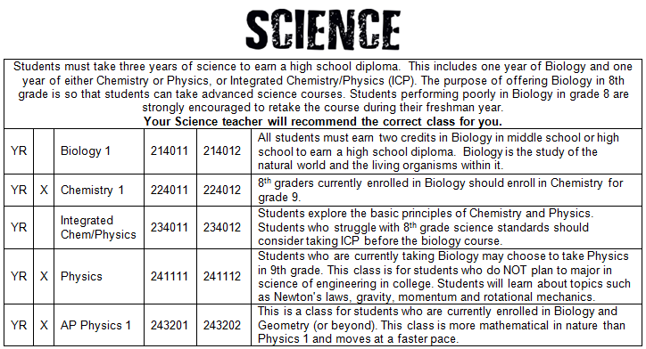
Circle the Science class that you believe is best for you.
Ask your Science teacher for his/her recommendation.

Slide 21
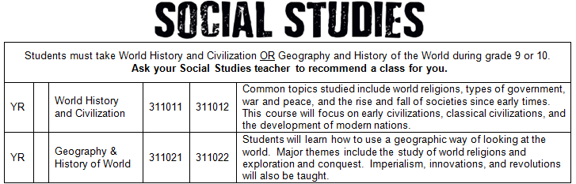

Slide 22
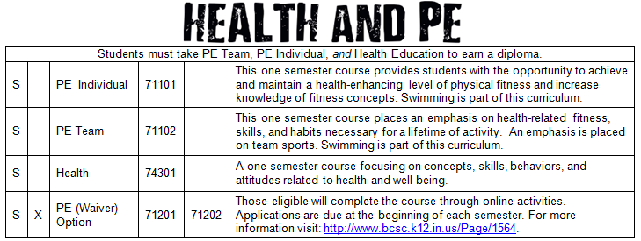

Slide 23

See electives you are interested in? Circle them!

Slide 24


Slide 25
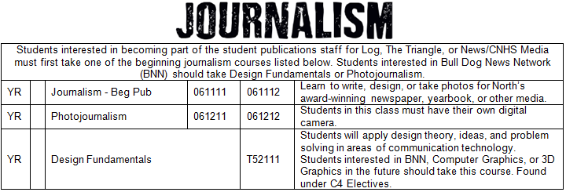

Slide 26
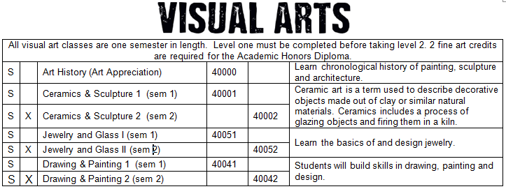

Slide 27
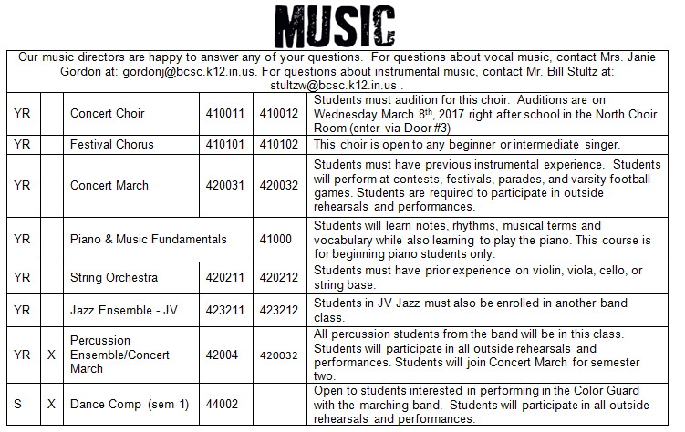

Slide 28
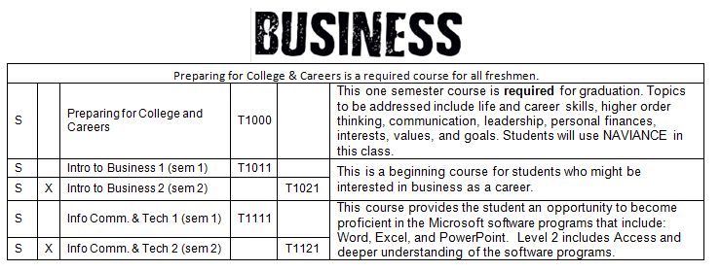
All 9th graders must take this course.

Slide 29
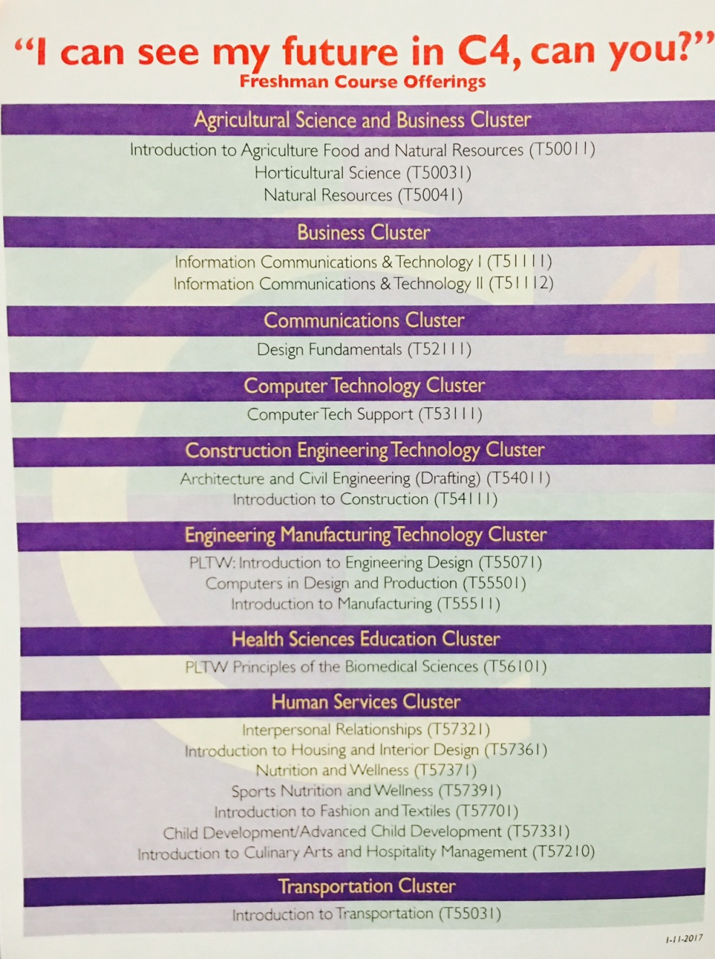
Choosing Classes

Slide 30
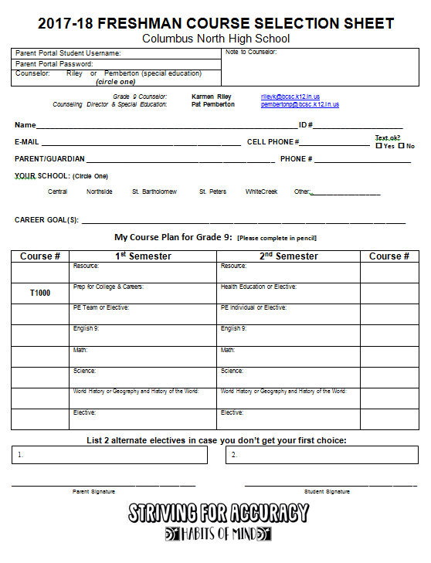
Course
Selection
Sheet

Slide 31

Course Selection Sheets
Complete your course
sheet in pencil

Slide 32
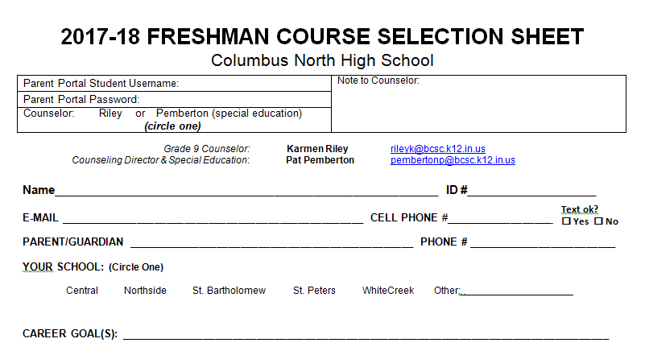
Choosing Classes
Karmen Riley
999222
rileyk@bcsc.k12.in.us
812-333-3333
Kevin & Vikki Riley
812-360-3333
Computers, Teaching, Nursing

Slide 33
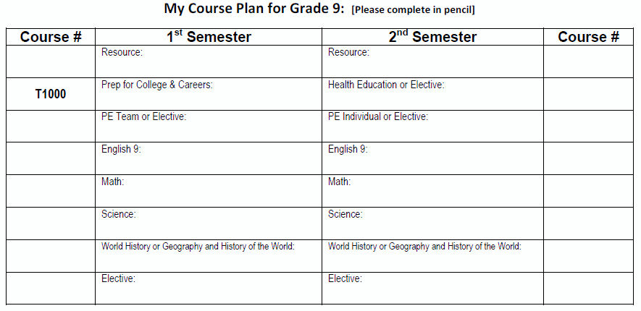
Sample Plan
99901
Resource
Resource
99903
PCC
Write in courses
Health
74301
410011
Concert March
Concert March
410012
012001
College Prep
College Prep
012002
Write course numbers
110312
110311
Algebra I
Algebra I
234011
ICP
ICP
234012
061111
Journalism- Beg Pub
Journalism- Beg Pub
061112
T52111
Select alternates
Design Fundamentals
Interpersonal Relationships
Nutrition & Wellness

Slide 34
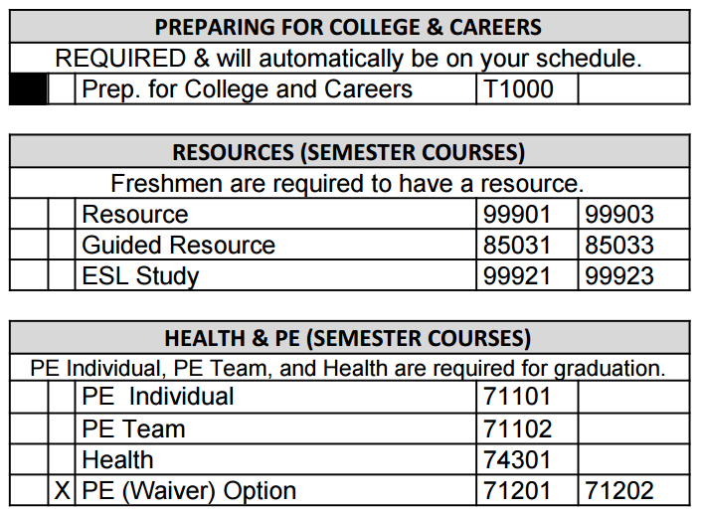
Mark course choices
Mark courses on the inside
Don’t mark ALTERNATES on the back!
If you are choosing the PE Waiver option, don’t forget to mark it on the inside; you do NOT write PE Option in the grid on the front page.

Slide 35
Computer Entry of Final Choices
Next week!
Meet individually with Mrs. Riley
Log in to student parent portal account
Input course choices for 9th grade!

Slide 36
Next Steps
Review high school choices with parents and teachers
Complete “My Course Plan for Grade 9” (front of Course Selection Sheet
Mark courses (in pencil) on page 2 of course selection sheet
Prepare to submit your courses for 9th grade in one week!

Slide 37
St. Bartholomew & St. Peters
Enrollment Paperwork

Slide 38
QUESTIONS?

Slide 39

Class of 2021

