Slide 1
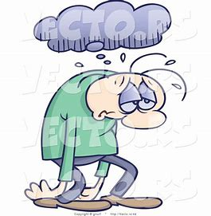
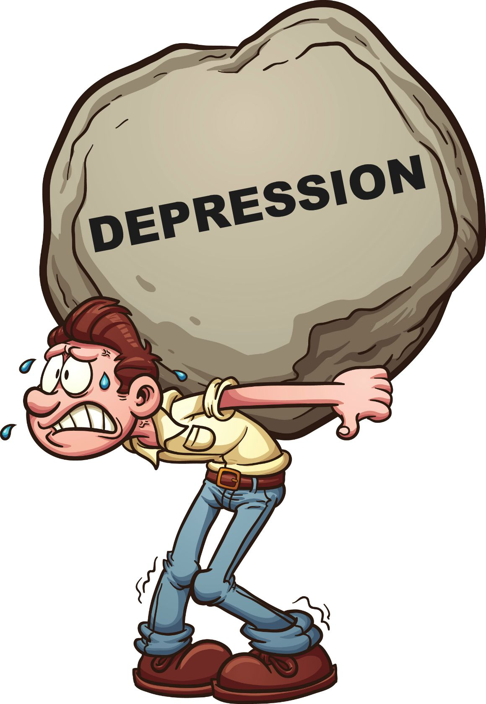
Depression

Slide 2
Take a moment and write down what comes to mind when you hear the word depression.

Slide 4
Sadness is just a normal feeling
Sadness is an emotional pain associated with, or characterized by, feelings of disadvantage, loss, despair, grief, helplessness, disappointment and sorrow.
Sadness

Slide 5
Difference between sadness and depression
Sadness lasts for a short period of time, depression can last for weeks or months at a time.
Sadness usually does not impact a person’s ability to function productively, whereas depression can.
Sadness is often times realistic in thought pattern, whereas depressed thoughts can be distorted and unrealistic.
Depression involves feelings of hopelessness and helplessness.
Depression is an illness.

Slide 6
Sadness vs Depression
Depression vs sadness https://www.youtube.com/watch?v=bCI68IfY0D8

Slide 7
Grief

Slide 8
Grief
Grief is a multifaceted response to loss, particularly to the loss of someone or something that has died, to which a bond or affection was formed.

Slide 9
Grief vs a Major Depressive Episode (DSM5)
GRIEF
Dominant affect is feelings of emptiness and loss
Dysphoria occurs in waves, vacillates with exposure to reminders and decreases with time.
Capacity for positive emotional experiences.
Self-esteem preserved
Fleeting thoughts of joining the deceased.
Major Depression
Dominate affect is depressed mood.
Persistent dysphoria that is accompanied by self-critical preoccupation and negative thoughts about the future.
Limited capacity to experience happiness or pleasure
Suicidal ideas about escaping life versus joining a loved one.

Slide 10
Grief vs Depression

Slide 11
Helping students in the grieving process.
Identify that they are grieving vs depression.
Educate on the grieving process
Feel- help them identify feelings and express them- good bye letter
Let them share their story
Help them to move forward

Slide 12
Some resources on grieving.
If you are going to work with young children you should be aware of this series: https://www.youtube.com/watch?v=s8M_5_JxY7k
Working with Children, Teens, Young adults- Adults- you will want to educate on grieving process. Grieving process
https://www.youtube.com/watch?v=mTHchH9VRh0

Slide 16
Depression
Depression is a mood disorder that causes a persistent feeling of sadness and loss of interest.
https://www.youtube.com/watch?v=7xPnUe6Xcbw

Slide 17
Some Statistics
1 in 5 children will go through a depression before finishing high school
8 of 100 children/teens have a major depression at any point in time.
Depression affects 3% of children and 6 – 8% of adolescents.
2 of 3 depressed teens are girls
It is estimated that about 10 to 15 percent of children and teens are depressed at any given time

Slide 18
What causes Depression
Family history (genetics)
Stress, including:
Conflict between parents, or with parents or siblings
Depression or too much stress in parents
Separation or divorce of parents
Conflicts with friends or classmates,
Social stress
School stress – not doing well, or too much pressure
Bullying
Loss of someone important

Slide 19
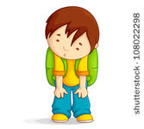
When to be concerned.
Feeling sad or depressed for more than 2 weeks
Increase in irritability and anger.
Drastic changes in behavior or personality
Not enjoying life, school or activities as much
Trouble coping with home, school or work

Slide 20
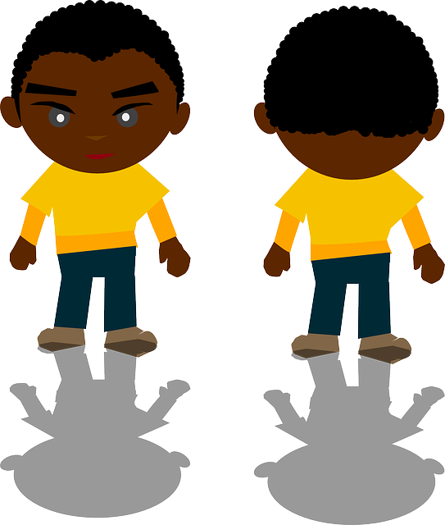
When to be concerned
Severe mood swings affecting ability to function
Feeling hopeless or worthless
Problems with sleep, appetite, energy and concentration, hygiene.
Expressions of wanting to die or plans to harm him/herself

Slide 22
Types of Depression
Disruptive Mood Dysregulation Disorder
Major Depression
Persistent Depressive Disorder
Premenstrual Dysphoric Disorder
Substance/Medication induced disorder
Depression Disorder due to another medical condition
Other specified depressive disorder
Unspecified depressive disorder
Type of depression https://www.youtube.com/watch?v=PbJB02Zlh4w

Slide 23
Mood Disorders
Childhood and adolescent depression are real
Mood disorders in children and adolescents are among the most common psychiatric disorders
50% of depressed adults had their first episode before age 20
Life events: stresses play a role in timing and onset

Slide 24
Types of mood disorders
MDD – 6.7% (14.8 mil. 18+), leading cause of disability in the U.S for ages 15-44.
Persistent Mood Disorder – 1.5% (3.3 mil.) median age of onset = 31
Bipolar D/O – 2.6% (5.7 mil.) median age of onset = 25

Slide 25
Comorbidity: MDD
High levels of comorbidity are found in both clinical and non-clinical samples (Angold and Costello, 1993)
Persistent Depression 30-80% onset age 8
Anxiety disorders 30-75% onset age 6
ADHD/Disruptive Disorders 60% onset age 4
Substance Use/Abuse 20-30% onset age 10
20-80% co-morbid with oppositional/conduct disorder (onset age 7-8)

Slide 26
Depression and Anxiety

Slide 27
Depression in Women
Women experience depression about twice as often as men.
Contributors:
Added stressors:
Work/life balance
Parenting, single-parenting
Caring for children and for aging parents
Hormonal factors:
Changes in menstrual cycle – pregnancy, miscarriage, postpartum period, pre-menopause, menopause

Slide 28
Depression in Men
Men are less likely to admit, less likely to be detected.
6 million men in the U.S affected.
Suicide in men is 4 x that of women (more women attempt).
Often masked by AOD, excessively long working hours.
Manifests as irritability, anger, discouragement rather than hopelessness/helplessness.

Slide 29
Diagnostic Evaluation
Complete history:
Of symptoms onset, duration, severity, impairment
Prior episode, treatment, remission
Type of treatment, response to treatment
Current/past SI/HI
AOD use, OTC, herbal supplements
Family history
Medical condition (most recent physical check-up)

Slide 30
Childhood Depression Can Be Treated
At least 70% - 80% of kids with depression can be effectively treated
Without treatment, 40% will have 2nd episode within 2 years
20% - 40% may go on to develop bipolar disorder
Most experience residual symptoms
72% experience recurrent episodes within 5 years

Slide 31
Treatment of Major Depression
Treatment methods may include
Individual psychotherapy
Family therapy
Medication

Slide 32
Treatment Consideration
Depends on diagnostic evaluation outcome/client’s learning style:
Psychotherapy – precipitating/sustaining factors, adaptive coping strategies (current/past/additional), maintenance/relapse prevention
Medication – symptoms/functional stability

Slide 33
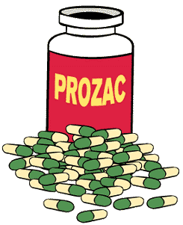
Treatment
Medication
Only used when other treatments don’t work, or when the depression is so severe that other treatments aren’t possible
Antidepressants are safe and effective when used correctly and monitored by a doctor

Slide 34
Treatment
Young children are most often treated with their family.
Working with parents to help them help their child
Family therapy if family problems are part of the problem
Cognitive Behavioral Therapy is proved to be very effective
The child learns ways to manage stress, do things that help her feel better, and think more positively.

Slide 35
Depression Psychopharmacological First Line Treatments
Fluoxetine (Prozac)
Sertraline (Zoloft)
Escitalopram) (Lexapro)
Citalopram (Celexa)
https://www.youtube.com/watch?v=trnG-vQweEo

Slide 36
CBT

Slide 37
CBT
CBT for Kids
Thought cards

Slide 38
Educate on the basics!
Get enough sleep
Eat healthy meals and snacks
Take vitamin D supplements and consider omega 3 fatty acids
Get exercise – an hour a day if possible.
Get enough sunlight (in winter, vitamin D supplements)
Plan enjoyable activities and one on one time with your child
Parents need to take care of themselves too!

Slide 39
Some Resources
Therapist aid https://www.therapistaid.com/therapy-worksheets/depression/adolescent
Rating Scales
Patient Health Questionnaire Modified for Teens (PHQ-9)
Mood and Feeling Questionnaire (MFQ)
Center for Epidemiological Studies Depression Scale for Children (CES-DC)
Quick Inventory of Depressive Symptomology (QIDS-A17-C)
Treatment https://www.youtube.com/watch?v=f6Ca60l4rgw
Cbt https://www.youtube.com/watch?v=PcFmrVZ0e-I

Slide 40
Question Time

