Slide 1
FRESHMEN ORIENTATION
CLASS OF 2024
WELCOME CULVER PARENTS AND STUDENTS

Slide 2
Your first step is learning the Language of High School
Required Credits
CTE Pathway
Employability Skills
Elective Credits
Dual Credit
Postsecondary Ready Competencies
Service-Based Learning
Work Product
Work-Based Learning

Slide 3
What does it take to
Earn a High School Diploma?
Graduation Pathway Plan
1
Diploma Type
Core 40
Academic Honors
Technical Honors
General Diploma
2
Learn & Demonstrate Employability Skills
3
Postsecondary Ready Competencies

Slide 4
Class of 2023
Indiana High School Diploma Options
Core 40
Core 40 Academic Honors
Core 40 Technical Honors
1

Slide 5
Subject Area | Credits | CORE 40 DIPLOMA
ENGLISH | 8 | Literature, Composition, and Speech English 9 – 12 fulfills this requirement
MATH | 6 | Algebra I, Geometry, Algebra II Must take a math or quantitative reasoning course each year
SCIENCE | 6 | 2 Credits: Biology I 2 Credits: Chemistry I, Physics I, or Integrated Chemistry/Physics plus 2 Credits: any Core 40 science course
SOCIAL STUDIES | 6 | 2 Credits: World History & Civilization or Geography & History of the World 2 Credits: U.S. History 1 Credit: U.S. Government 1 Credit: Economics
PHYSICAL ED. | 2
HEALTH | 1 | Health and Wellness
DIRECTED ELECTIVES | 5 | World Language or Fine Arts or Career & Technical Education
ELECTIVES | 6 | Career Academic Sequence recommended
TOTAL | 40 | Credits to earn a Core 40 Diploma

Slide 6
Core 40 with Academic Honors 47 Credits
Subject Area | Credits | Classes
English/LA | 8 | Literature, Composition, and Speech English 9 – 12 fulfills this requirement
Math | 8 | Algebra I, Geometry, Algebra II, plus any Core 40 Math Class Must take a math or quantitative reasoning course each year
Science | 6 | 2 Credits: Biology I 2 Credits: Chemistry I, Physics I, or Integrated Chemistry/Physics 2 Credits: any Core 40 science course
Social Studies | 6 | 2 Credits: World History/Civilization or Geography & History/World 2 Credits: US History 1 Credit: US Government 1 Credit: Economics
World Languages | 6 - 8 | 6 credits in a single language or 4 credits in each of two different languages
Fine Arts | 2 | Music, Theatre, Visual Arts
Physical Ed. | 2
Health | 1 | Health & Wellness
Electives | 7- 8 | Core 40 courses
TOTAL | 47 | Credits required for Core 40 with Academic Honors

Slide 7
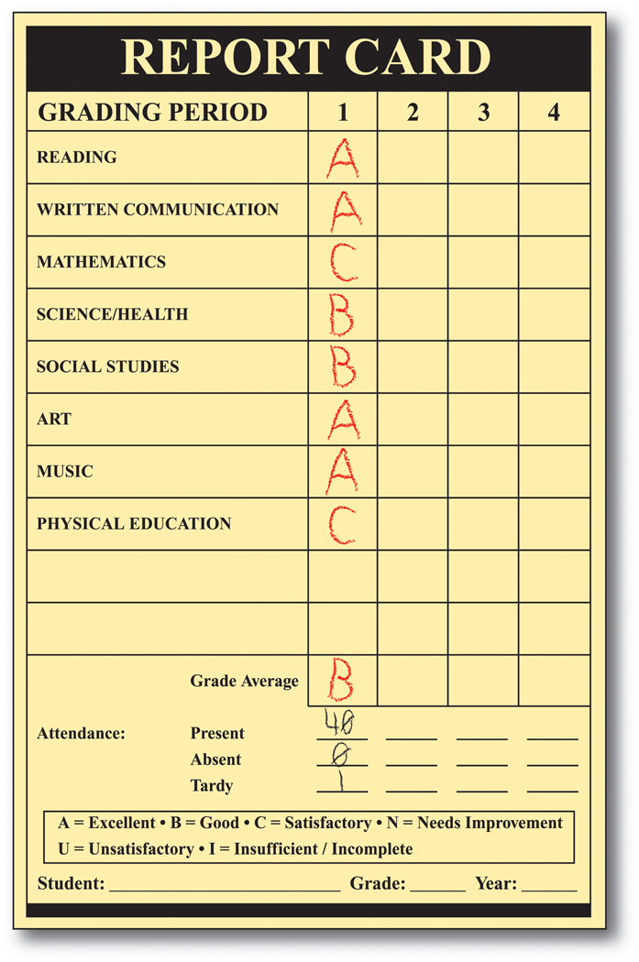
Core 40 with Academic Honors 47 Credits
There are a few more requirements . . .
Grade Requirements
Earn a grade of “C” or better in courses that will count toward the diploma
Have a grade point average of a “B” or better
NOTE: Students do not have to be in Honors Classes to earn an Academic Honors Diploma.

Slide 8
Core 40 with Academic Honors 47 Credits
There are a few more requirements . . .
Complete one of the following:
Earn 4 credits in 2 or more AP courses and take corresponding AP exams
Earn 6 verifiable transcripted college credits from the approved dual credit list
C. Earn the following two:
Minimum of 3 transcripted college credits
2. Two credits in AP courses/corresponding exams
D. Earn a composite score of 1750 or higher on the SAT
critical reading, math, and writing sections and a
minimum score of 530 on each section
E. Earn an ACT composite score of 26 or
higher and complete the written section
This Photo by Unknown Author is licensed under CC BY-NC-ND

Slide 9
Core 40 with Technical Honors 47 Credits
Subject Area | Credits | Classes
English/LA | 8 | Literature, Composition, and Speech English 9 – 12 fulfills this requirement
Math | 6 | Algebra I, Geometry, Algebra II Must take a math or quantitative reasoning course each year
Science | 6 | 2 Credits: Biology I 2 Credits: Chemistry I, Physics I, or Integrated Chemistry/Physics 2 Credits: any Core 40 science course
Social Studies | 6 | 2 Credits: World History/Civilization or Geography & History/World 2 Credits: US History 1 Credit: US Government 1 Credit: Economics
College and Career Pathways | 6 or more | Earn 6 credits in a state-approved College & Career Pathway and one of the following: 1. State approved industry-based certification or credential 2. Pathway dual credits resulting in 6 transcripted college credits
Physical Ed. | 2
Health | 1 | Health & Wellness
Electives | 5 - 9 | Core 40 courses, World Languages, Fine Arts, or other CTE courses.
TOTAL | 47 | Credits required for Core 40 with Technical Honors

Slide 10
Core 40 with Technical Honors 47 Credits
There are a few more requirements
Grade Requirements
Earn a grade of “C” or better in courses that will count toward the diploma
Have a grade point average of a “B” or better
Complete One of the following
Any one of options (A-E) of the Core 40 with Academic Honors
Earn the following scores on WorkKeys:
Reading for Information – Level 6
Applied Math – Level 6
Locating Information - Level 5
Earn the following minimum scores on Accuplacer:
Writing 80; Reading 90; and Math 75

Slide 11
Indiana Grad Pathway
Steps 2 & 3
Graduation Pathway Plan
2
Learn & Demonstrate Employability Skills
3
Postsecondary Ready Competencies

Slide 12
Indiana’s Employability Skills Benchmarks
Employability Skills
2
Career Mindset
Self-Management Skills
Learning Skills
Social Skills
Workplace Skills
Demonstrated via work products, extra-curricular participation, employment, and other school approved activities/programs.
Indiana Department of Workforce Development

Slide 13
Student MUST complete one of the following to meet the Employability Skills Graduation Pathway
Employability Skills
PROJECT-BASED LEARNING
2
Currently there are no defined PBL opportunities.
B. SERVICE-BASED LEARNING
School sponsored activities including athletic participation, co-curriculars. Approved service based experiences completed outside of the school day. All experiences verified via sponsor or coach.
C. WORK-BASED LEARNING
Employment with employer verification or completion of school based work program.

Slide 14
WORK PRODUCT
How is the Employability Skills Experience documented?
Employability Skills
2
All Students are Required to Complete a Senior Portfolio:
Resume with three references and a cover letter
Credit Tracking Form/Official Transcript
Indiana Career Explorer Summary Report
Completed College Application OR Employment Application
21st Century Scholars Only – MUST Complete Scholar Track
STUDENTS WILL CHOOSE ONE WBL or SBL in addition to completing their senior portfolio.

Slide 15
When can these experiences begin?
Employability Skills
Anytime between July 1 prior to freshman year through graduation
Can be during the school day, after school, during breaks, etc.
2
How long do they have to last?
There is not a set number of hours for the Employability Skills experience, but the experience must be sustained over a period of time, such as:
One Semester
75-100 hours or more
Marked by earning a credit
Other local CHS requirement

Slide 16
POSTSECONDARY-READY COMPETENCIES
3
What does this mean?
Postsecondary refers to the additional education or training options that you can select from after high school, such as, apprenticeship training, military, entering a career training program, earning certification required for a specific career, attending a two or four-year college, or other options.
WHY? High school is that time period that you learn about and prepare for a specific career area through the classes you take and the activities you participate in to develop your employability skills. These experiences will help you select the right postsecondary option that aligns with your career area of interest.
The Postsecondary Ready Competency – graduation requirement means you have to prove your postsecondary readiness through one of several options:
This Photo by Unknown Author is licensed under CC BY
Notes:
HEA – Means House Enrolled Act
SEA – Means Senate Enrolled Act

Slide 17
POSTSECONDARY-READY COMPETENCIES
3
Students must complete ONE of the experiences below
Core 40 with Academic or Technical Honors Diploma | SAT or ACT | Advanced Placement Courses or Dual Credits
Career & Technical Education Concentrator | Industry Certification | ASVAB
This Photo by Unknown Author is licensed under CC BY
Notes:
HEA – Means House Enrolled Act
SEA – Means Senate Enrolled Act

Slide 18
POSTSECONDARY-READY COMPETENCIES
3
Core 40 with Honors Diploma | SAT | ACT | Advanced Placement Courses or Dual Credits
Academic Honors Technical Honors | Evidence Based Reading & Writing=480 Math=530 Can Super score Must meet individual scores in each subject | English = 18 or Reading = 22 AND Math = 22 or Science = 23 Can Super score | Must earn a “C” average or higher in at least three(3) courses One of the three courses must be in core content or be part of a CTE Pathway
This Photo by Unknown Author is licensed under CC BY
Notes:
HEA – Means House Enrolled Act
SEA – Means Senate Enrolled Act

Slide 19
POSTSECONDARY-READY COMPETENCIES
3
Career & Technical Education Concentrator | Industry Certification | ASVAB AFQT
Must earn a “C” average or higher in at least 2 advanced courses in a CTE Pathway *Important to select a career area of study while in high school | Must earn one certification from the Industry Certification list approved by the Department of Workforce Development | The minimum AFQT score a student must earn is 31
This Photo by Unknown Author is licensed under CC BY
Notes:
HEA – Means House Enrolled Act
SEA – Means Senate Enrolled Act

Slide 20
CAREER CLUSTERS - 16 National Career Clusters

Slide 21
CAREER OPTIONS—Find What Interests You!
CTE Pathway – Career & Technical Education Pathway
A Career Pathway is a series of classes focused on a specific career field. These classes provide opportunities for students to learn about a career area and may include dual credit options, industry certification, and/or work-based learning experiences through internships or job placement.
CCMHS provides students numerous Career Pathway options at the school and NCAVC – North Central Area Vocational Cooperative
Take advantage of these CTE Pathway courses by planning these classes into your high school schedule

Slide 22
CAREER PATHWAYS – MORE OPTIONS
CAREER AREA | CAREER PATHWAY PROGRAM | Program Provider
Agriculture | Agribusiness | CCMHS
Agriculture | Animal Science | CCMHS
Architecture & Construction | Construction Technology | NCAVC
Agriculture | Food Science | CCMHS
Business & Marketing | Entrepreneurship & Management Focus | CCMHS
Education & Training | Early Childhood Education & Services | NCAVC
Education & Training | Education Careers | NCAVC
Health Science | Health Science Careers | NCAVC
Hospitality & Human Services | Culinary Arts | NCAVC
Information Technology | Networking | NCAVC
Manufacturing & Logistics | Welding Technology | NCVAC
Public Safety | Criminal Justice | NCAVC
Transportation & Logistics | Automotive Technology | NCAVC
Transportation & Logistics | Aviation Flight & Operations or Aviation Maintenance | NCAVC

Slide 23
What do successful high school students need to do?
Select a broad career field in high school
Select courses that prepare you for this career
Research the jobs in this career to find out options
Make every course selection count
Attend school regularly and on time – 95% attendance rate
Participate in school and community based activities

Slide 24
Remember – You need to complete these three (3) tasks to earn a CCMHS Diploma!
1
Diploma Credits
2
Learn & Demonstrate Employability Skills
3
Postsecondary Ready Competencies
Culver Community Middle High School

Slide 25
Questions?
Graduation Pathway Plan

